Slide 1
Can we predict the number of bikes shared at a given hour?
London Bike Sharing dataset
By Paula Onea

Slide 2

Dataset $≫$ tools to be used
Dataset:
2 years of available data (17k entries)
9 factors that influence the number of bikes shared
Tools:
Try machine learning algorithm -> used of one of the first algorithmically described machine learning algorithms for classification, the perceptron and adaptive linear neurons
Also used: Pandas and NumPy – modules to manipulate data
Matplotlib and Seaborn – modules for plotting
Datetime – module for working with datetime objects

Slide 3
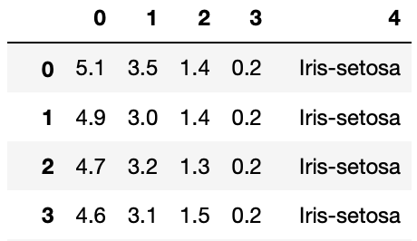
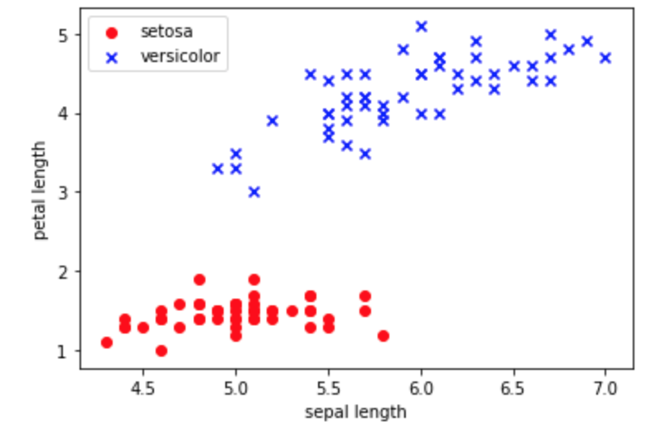
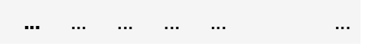
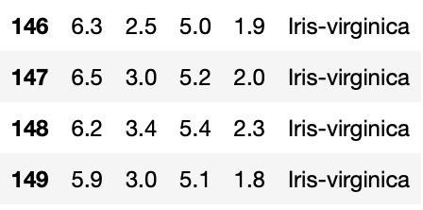
Example Iris dataset
Dataset:
First 100 entries, 2 very distinct classes

Slide 4
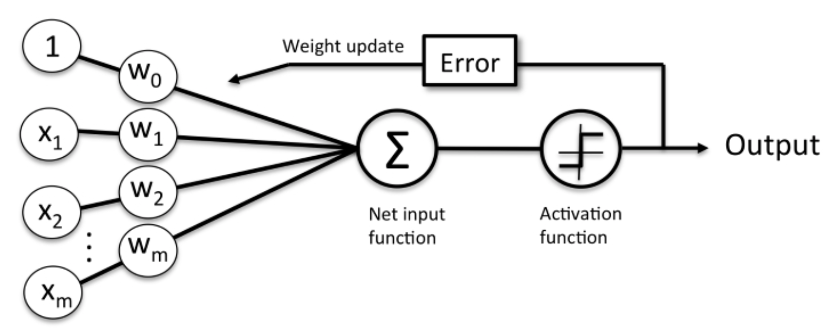
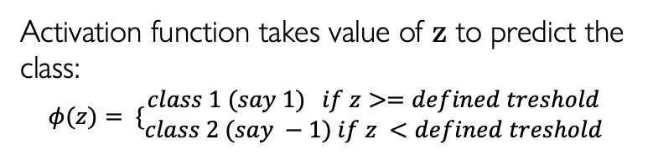
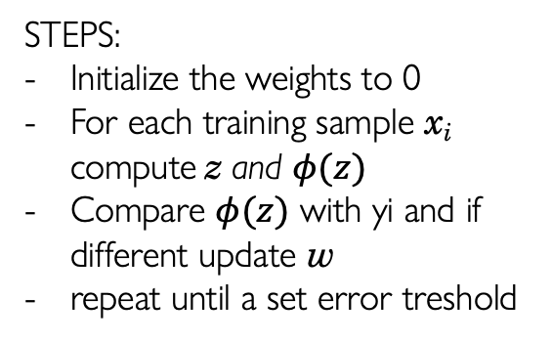

How the perceptron works
Learning Data - MATRIX – every row represents the influencing factors:
Every row in the matrix is weighted using a weighting vector :
w = [w₁ w₂ w₃ … w_{m}]
Compute net input z
(vector dot product):
z = w₁x₁ + w₁x₁ + … w_{m}x_{m}
Activation function takes value of z to predict the class:
$$φ(z)= \{\begin{matrix}class 1 (say 1) if z>=defined treshold \\ class 2 (say −1) if z <defined treshold\end{matrix}$$
Matrix X
vector y
n rows
x₁₁ x₁₂ … x_{1m}
x₂₁ x₂₂ … x_{2m}
… … … …
x_{n1} x_{n2 …} x_{nm}
y₁
y₂
…
y_{n}
Compare $φ(z)$ with yi and if different update w using a formula (outside the scope of this presentation)
m influencing factors
known
outputs
STEPS:
Initialize the weights to 0
For each training sample x_{i} compute z and $φ(z)$
Compare $φ(z)$ with yi and if different update w
repeat until a set error treshold

Slide 5
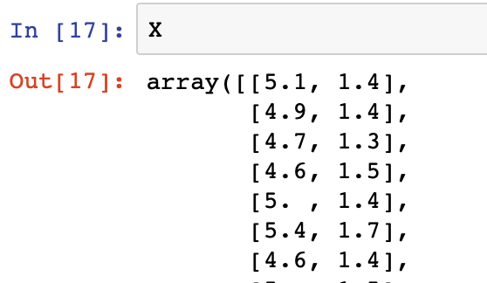
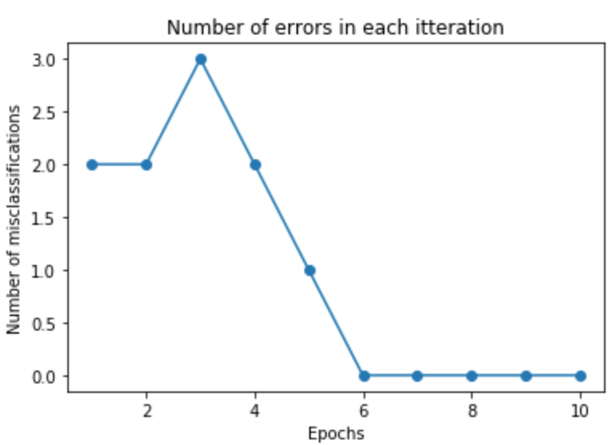
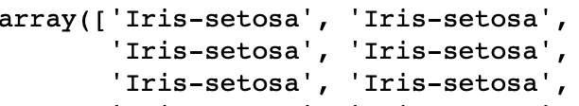
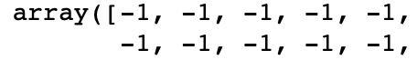
Example Iris dataset – prepare data and apply perceptron
Matrix X = the values of columns 1 and 3:
X = df.iloc[0:100, [0, 2]].values
Dataset:
Learning curve of the algorithm
y = known output = the name of flowers
y = df.iloc[0:100, 4].values
Initialise y with 1 and -1 based on the values:
y = np.where(y == 'Iris-setosa', -1, 1)

Slide 6
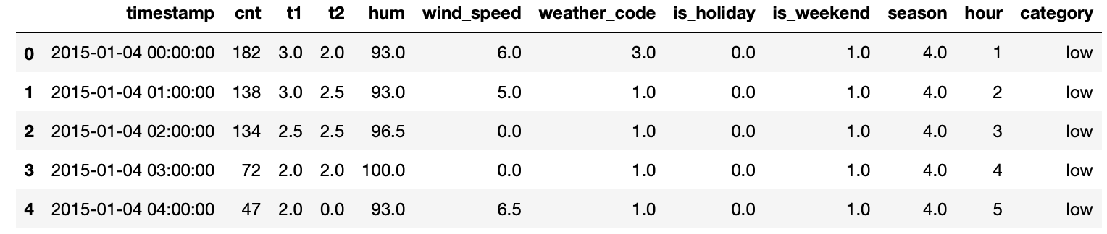
London Bike Sharing dataset
Prep dataset
‘timestamp’ = string >> datetime
Updated ‘season’ to avoid zero-s
Hour is an important factor >> added one column for hour
Set-up the knows category >> added one column with ‘low’ and ‘high’, threshold = 1600 units
2. Updated dataframe looks like this:

Slide 7
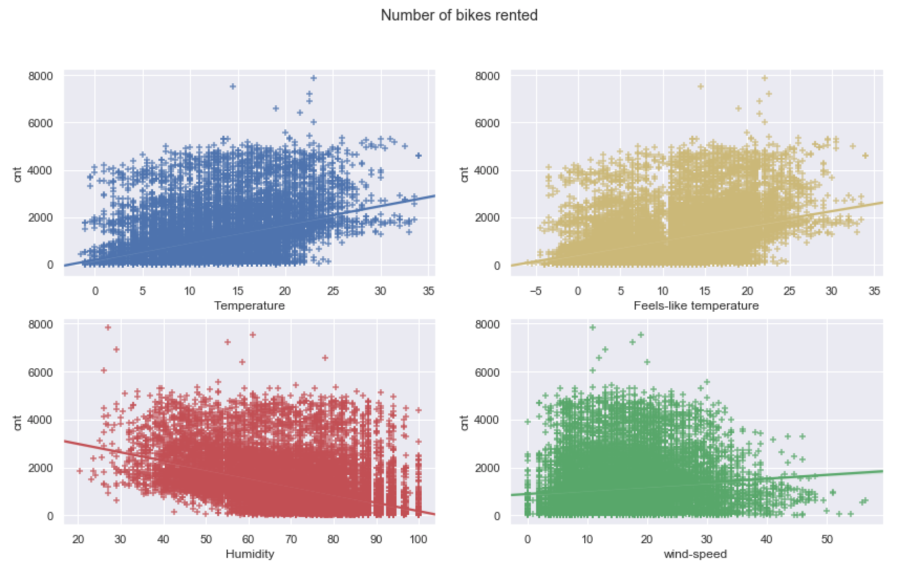
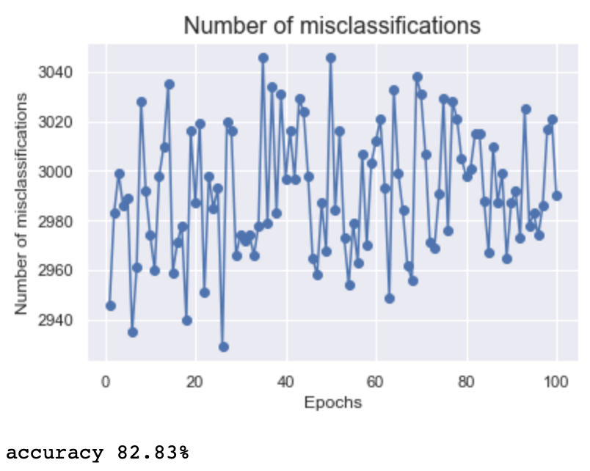
Trial 1 – full dataset

Slide 8
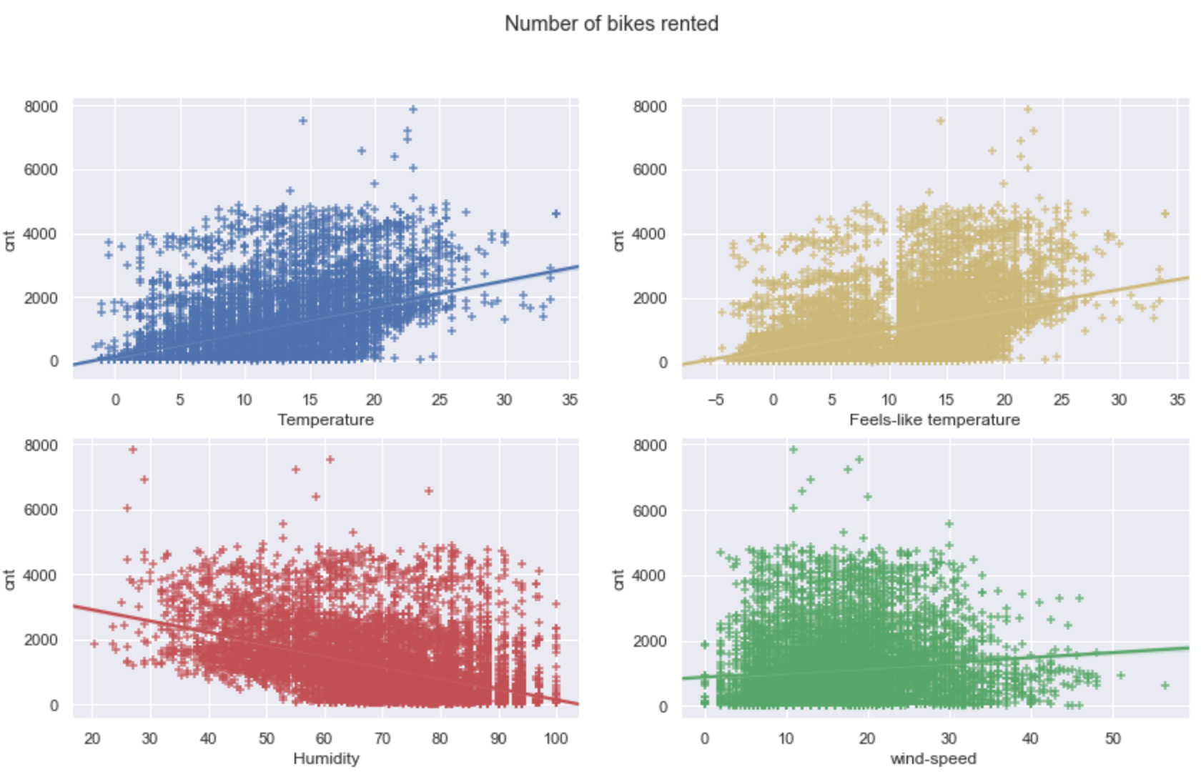
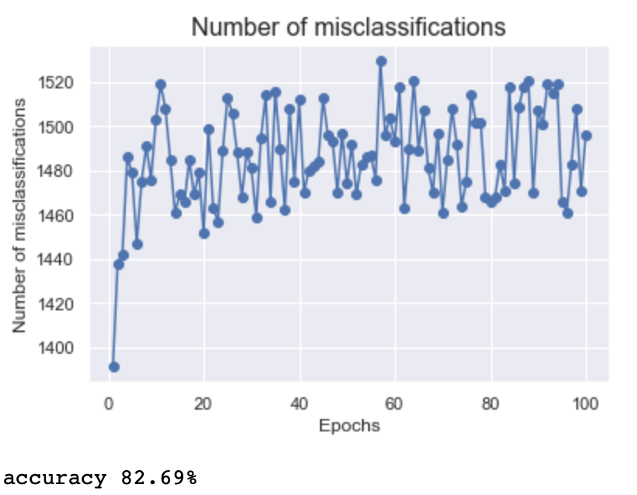
Trial 2 – year 2015

Slide 9
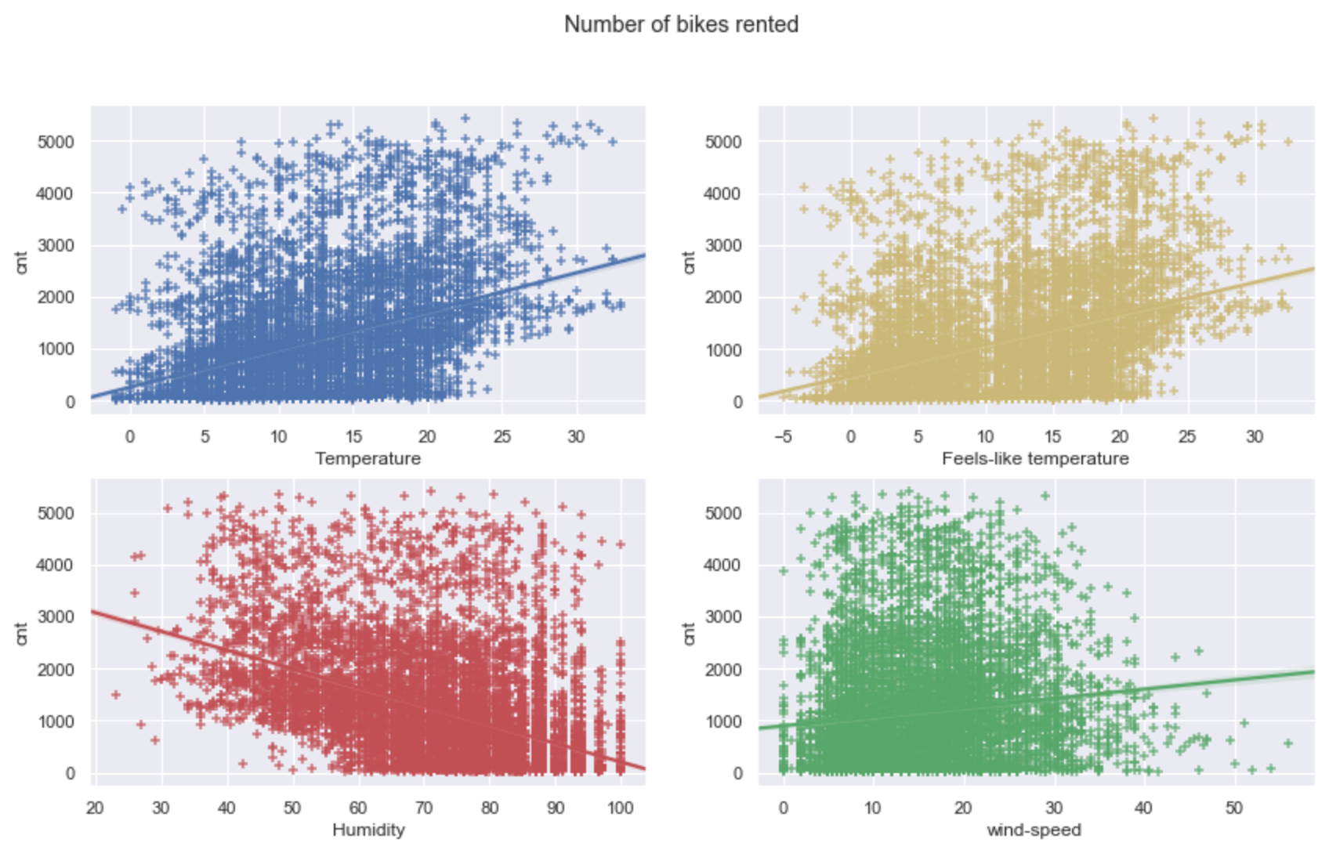
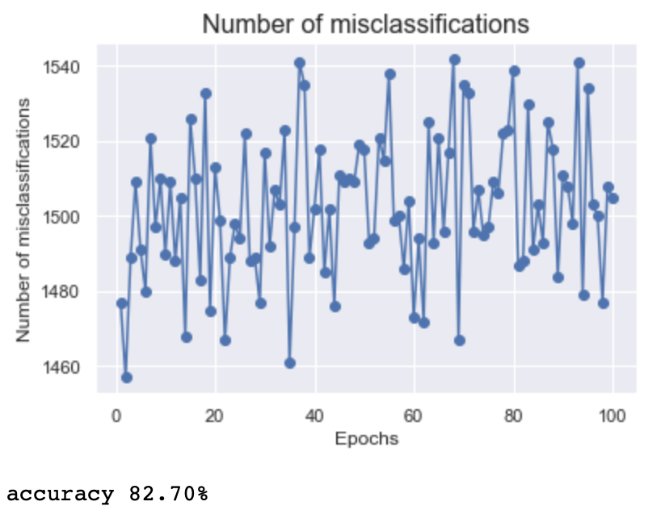
Trial 3 – year 2016

Slide 10
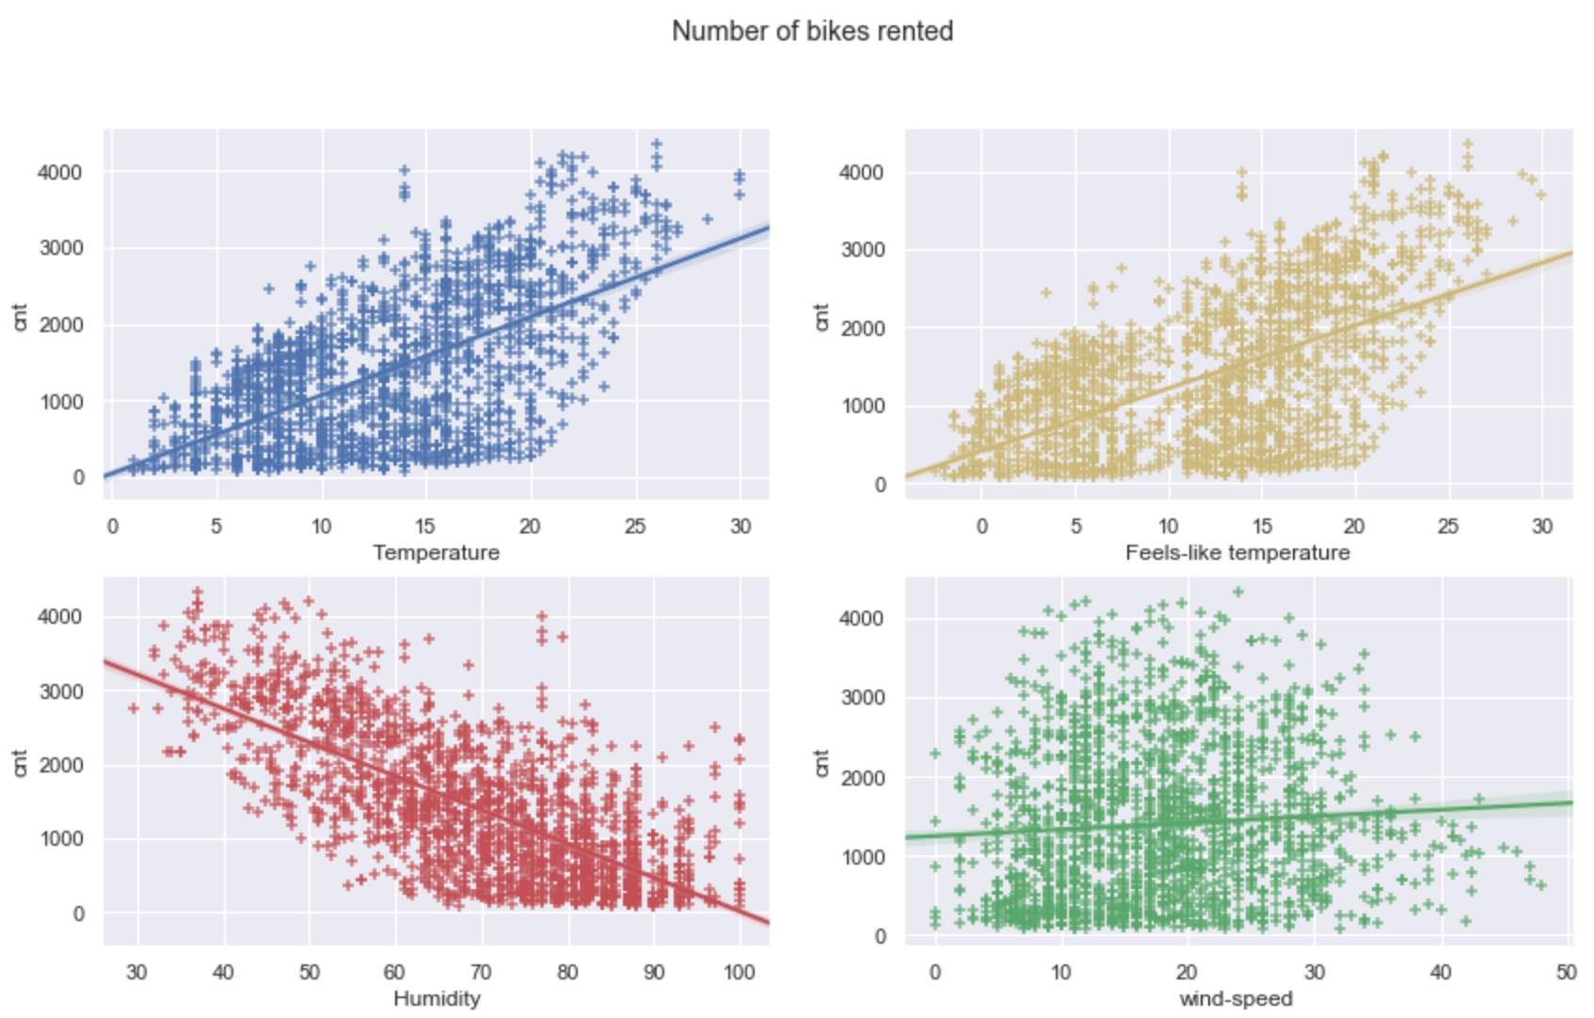
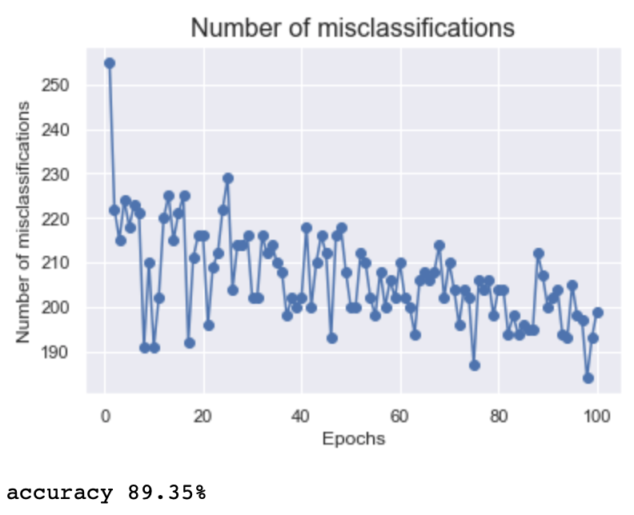
Trial 4 – manually selecting subset
Time of day may influence renting, let’s keep daytime only. What about weekends?
Selection: time between 8am and 5pm, weekend:
df_subset1 = df[(df.hour >=8) & (df.hour < 17) & (df.is_weekend == 1)]

Slide 11
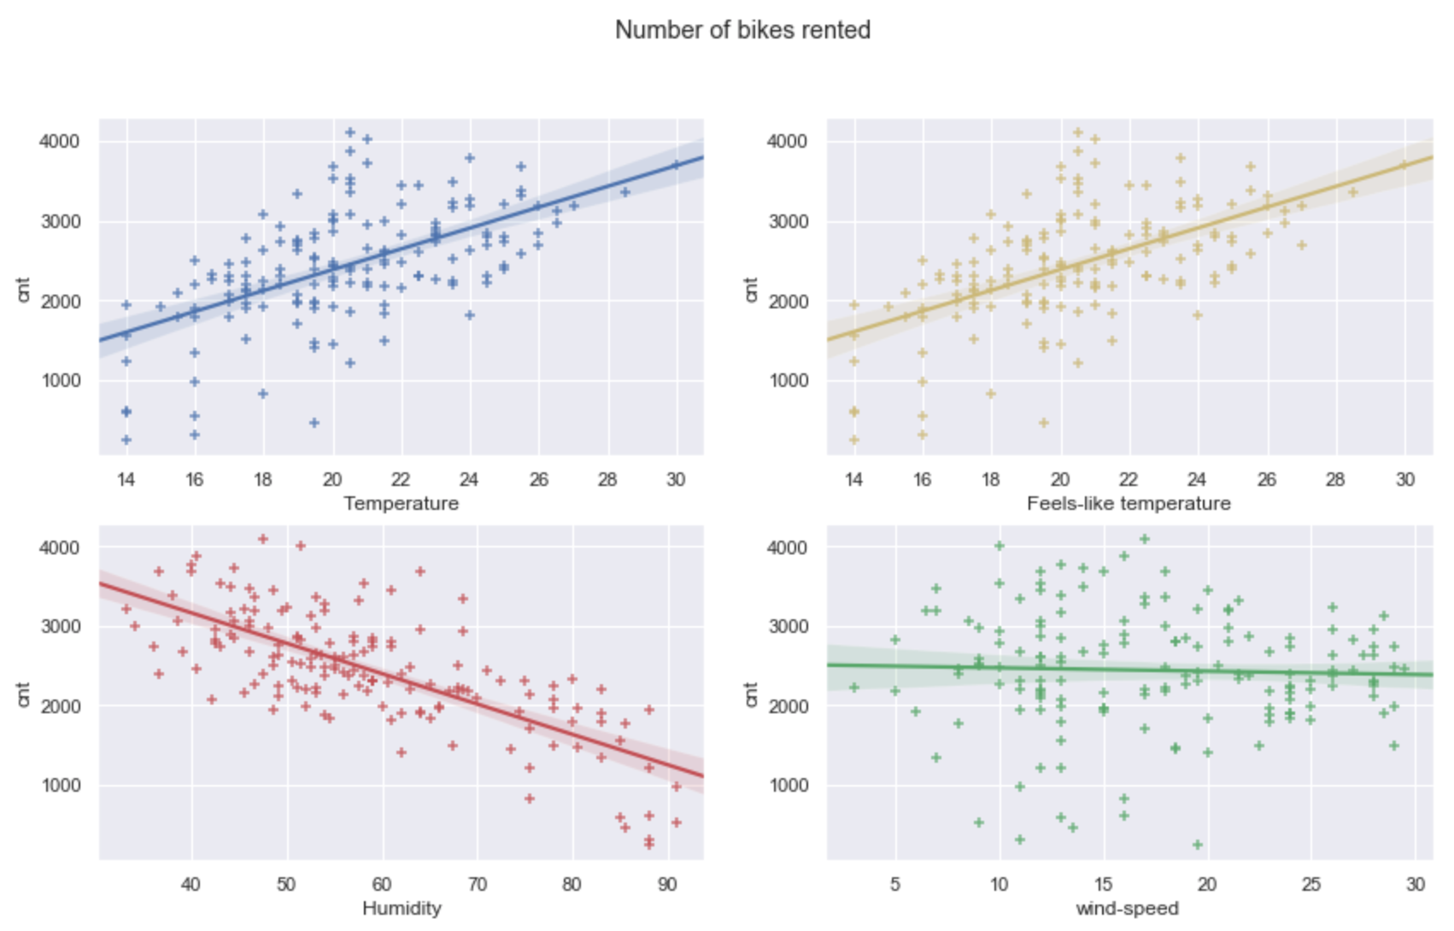
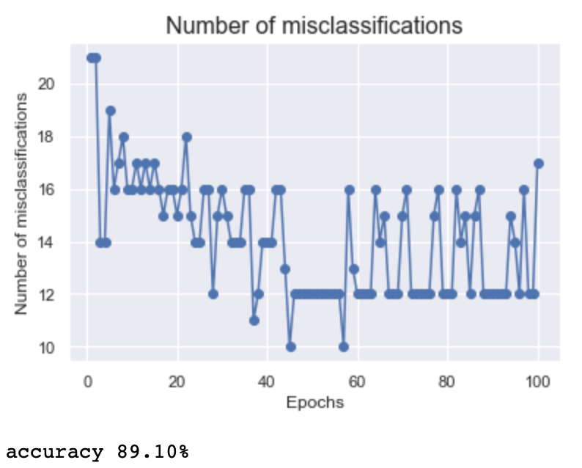
Trial 5 – manually selecting subset
Let’s see midday, weekend, summer:
df_subset2 = df[(df.hour >=12) & (df.hour <= 14) & (df.is_weekend == 1) & (df.season == 2)]

Slide 12
Conclusions – next steps
Perceptron is guaranteed only if the two classes are linearly separable.
If the two classes can't be separated by a linear boundary, the accuracy will never be 100% and the perceptron will never stop updating the weights >>> we can set a maximum number of iterations over the training dataset and/or a threshold for the number of tolerated misclassifications
Try other machine learning models.

